Slide 1
IRELAND

Slide 2
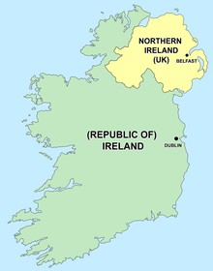
4 million inhabitants
2 official languages – English and Irish

Slide 3
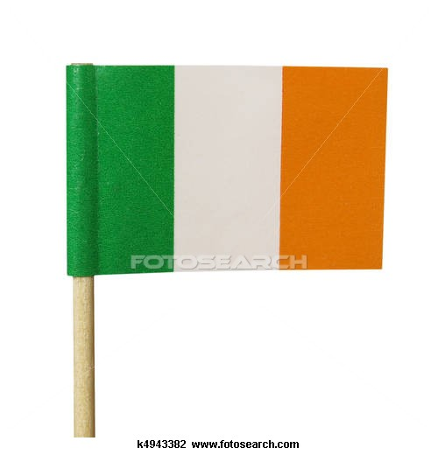
GREEN
REPRESENTS
CATHOLICS
ORANGE
REPRESENTS
PROTESTANTS
WHITE REPRESENTS PEACE BETWEEN CATHOLICS AND PROTESTANTS

Slide 4
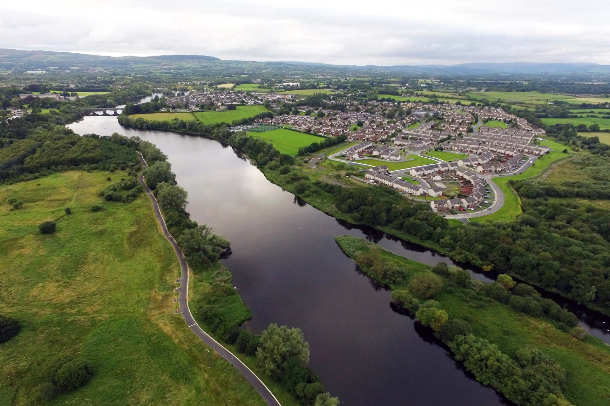
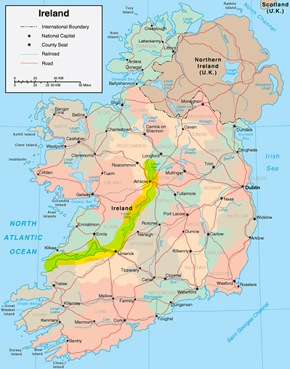
River Shannon – the longest and the most important river

Slide 5
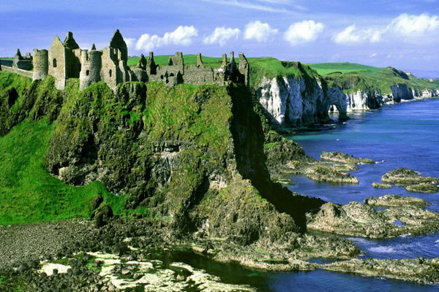
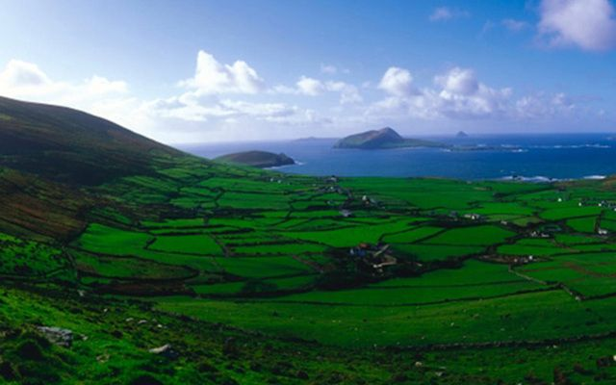
“Emerald Isle”- green colour of the countryside

Slide 6
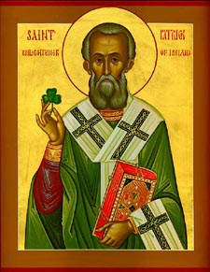
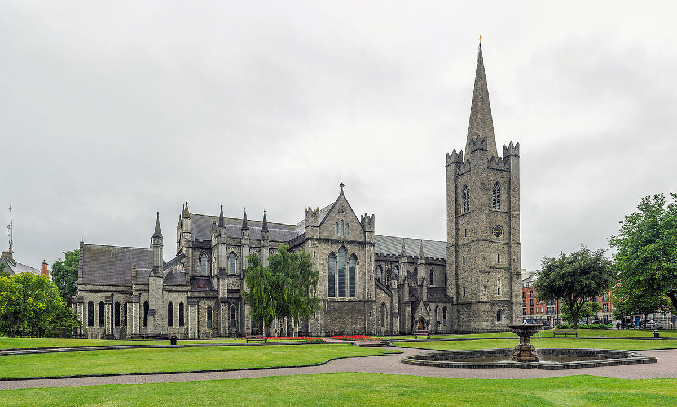
St Patrick
brought Christianity to Ireland
freed Ireland of snakes
St Patrick’s Church in Dublin

Slide 7
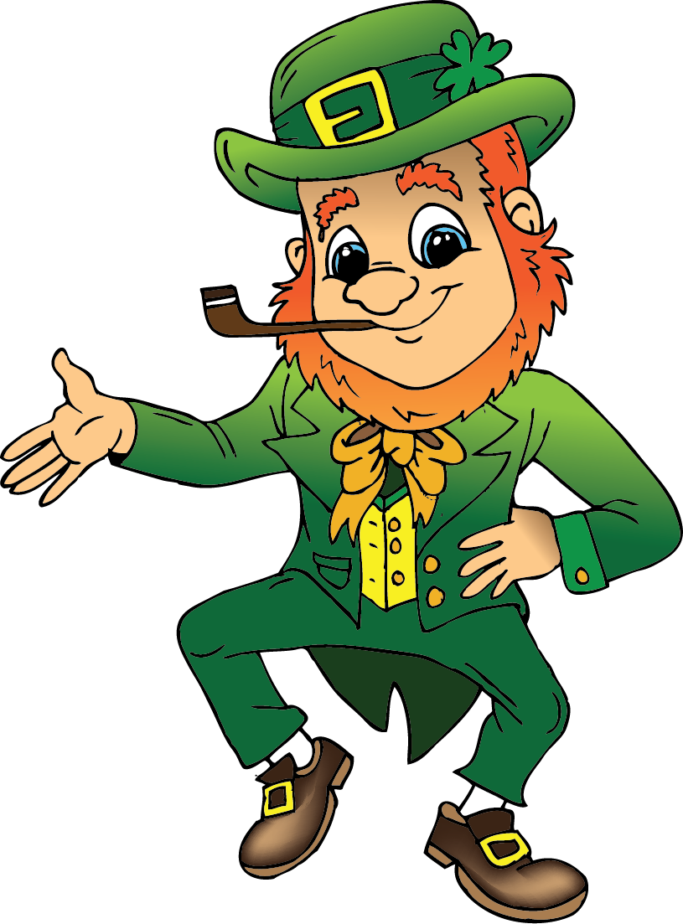
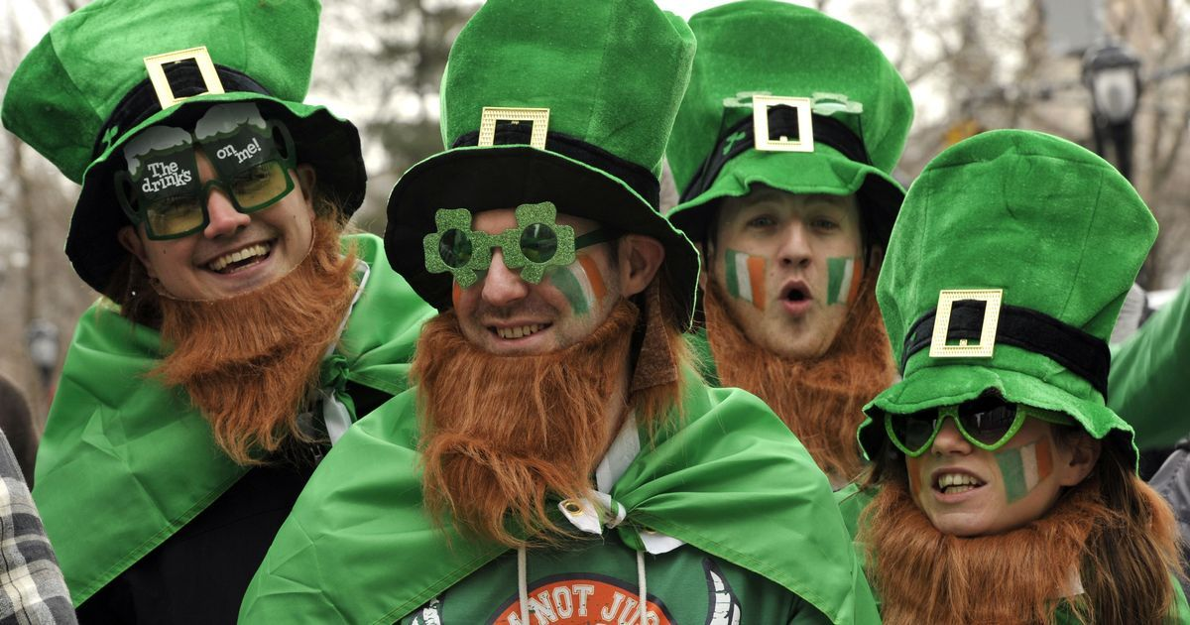
17th March – St Patrick’s Day
leprechaun

Slide 8
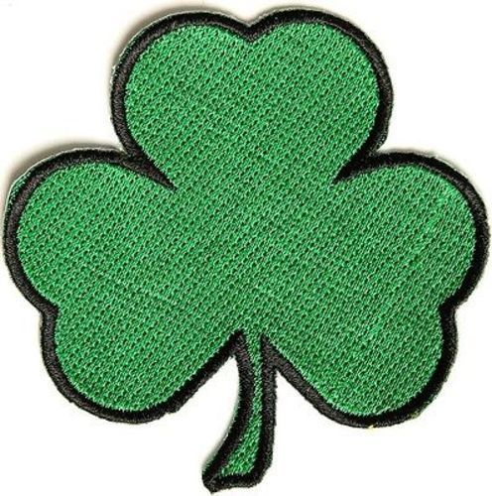
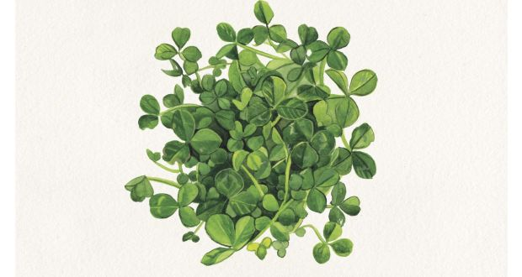
Shamrock
metaphor for the Christian Holy Trinity
the symbol of Ireland

Slide 9
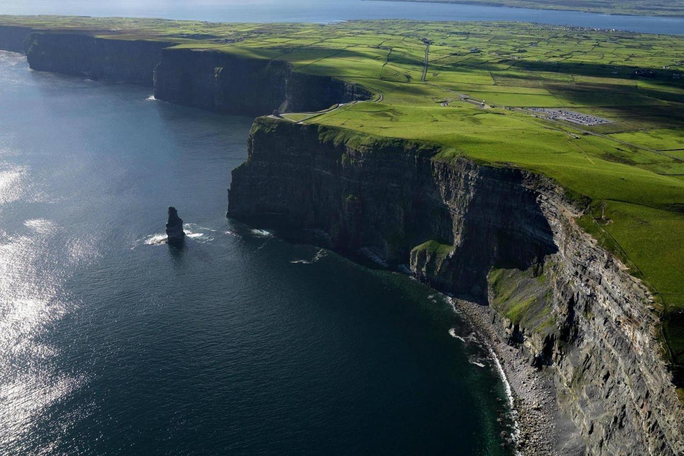
The Cliffs of Moher

Slide 10
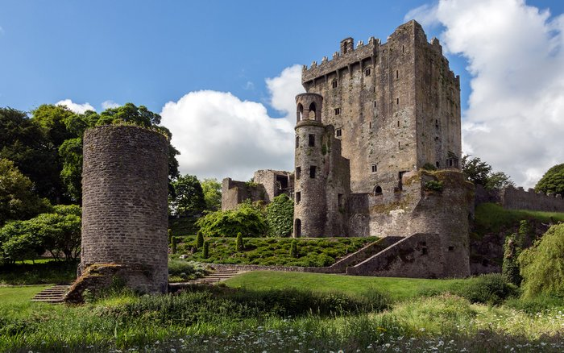
Blarney Castle

Slide 11
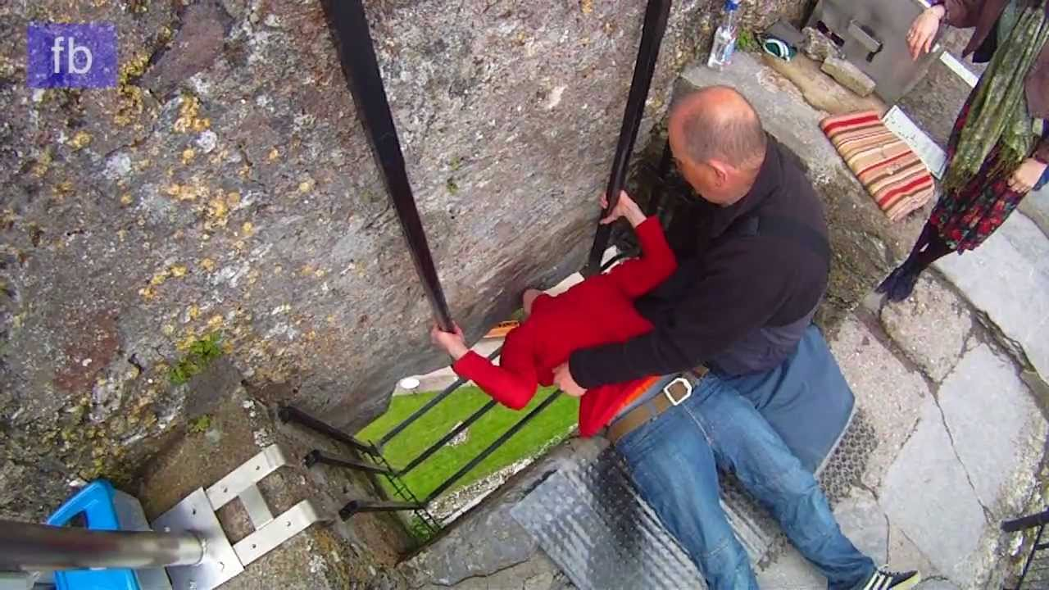
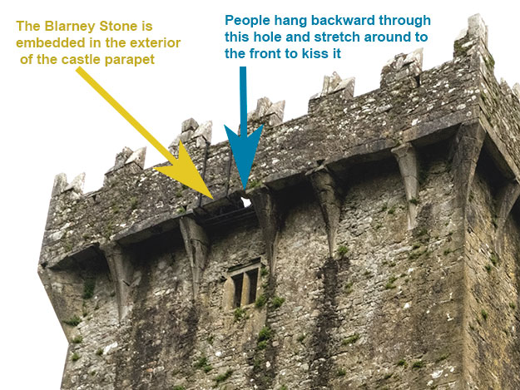
Blarney Stone
gift of eloquence

Slide 12
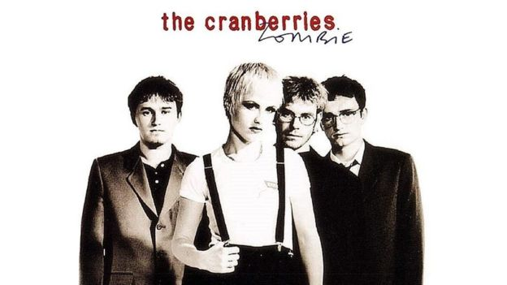
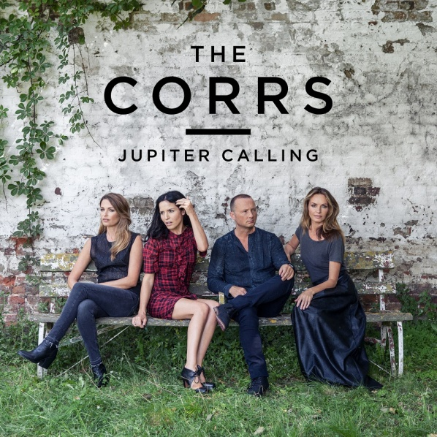
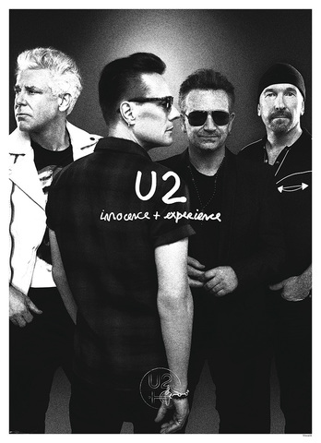
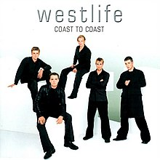
Famous pop groups

Slide 13
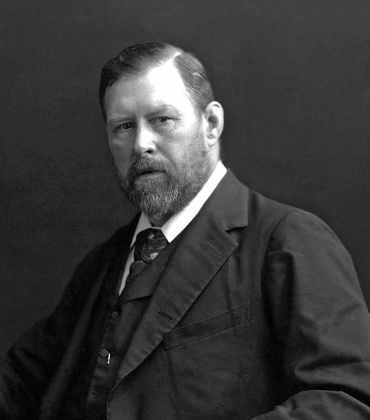
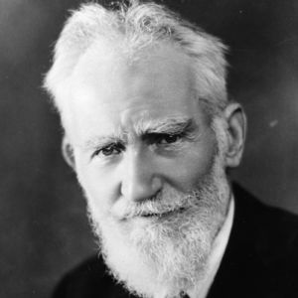
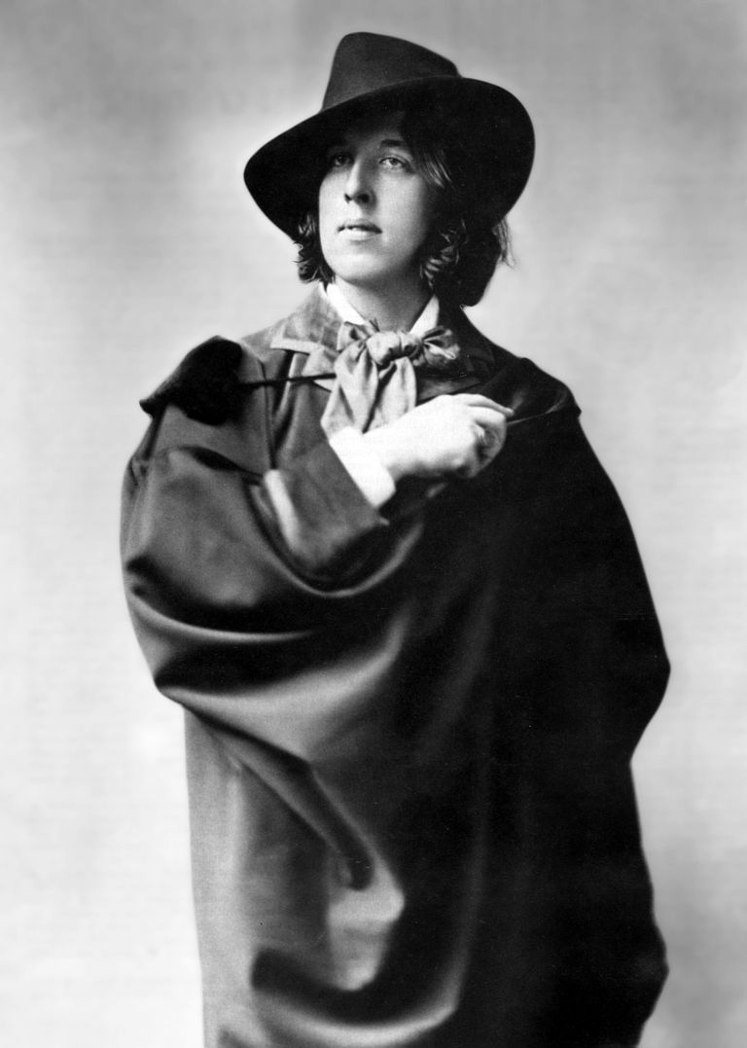
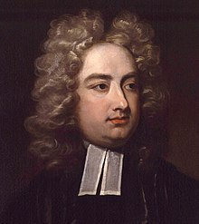
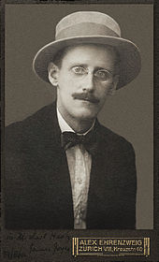
Irish writers
George Bernard Shaw
Bram Stoker
Oscar Wilde
Jonathan Swift
James Joyce

Slide 14
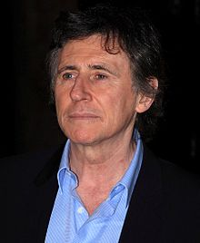
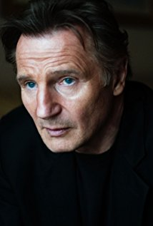
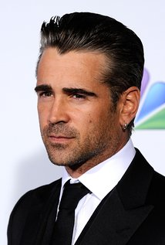
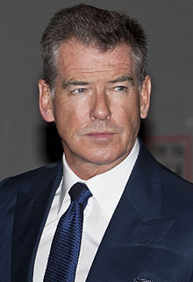
Irish actors
Gabriel Byrne
Liam Neeson
Colin Farrell
Pierce Brosnan

Slide 15
Fun facts
Many Irish family names start with Mac or O' (son of ... and grandson of ... in Gaelic)
Ireland has won seven times the Eurovision Song Contest.
Ireland is a snake-free island.
It is estimated that over 80 million people of Irish descent live outside Ireland.

