Slide 1
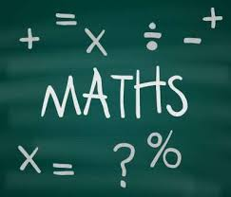
There’s no time like school time
New Building Bridges 8, pages 132, 133

Slide 2
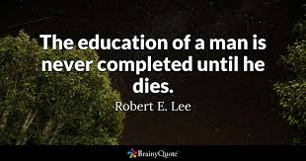
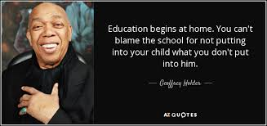
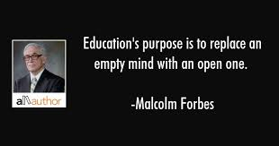
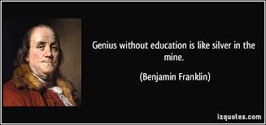
Look at the quotes about school and education. What do you think? Do you agree or disagree with them?

Slide 3
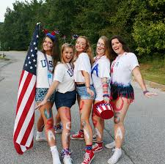
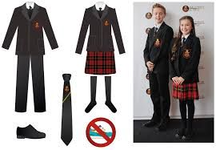
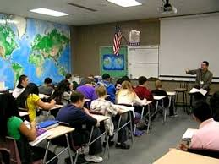
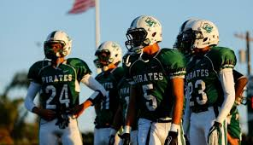
How much do you know about education in the UK and the USA?
Do the quiz in your books.

Slide 4
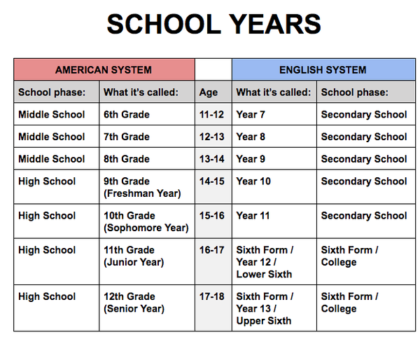
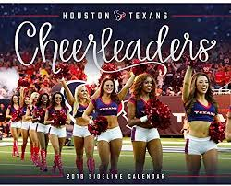
These might help you

Slide 5
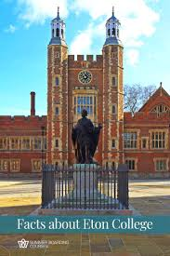
https://dictionary.cambridge.org/dictionary/english/gcse https://www.collinsdictionary.com/dictionary/english/a-level https://en.wikipedia.org/wiki/SAT http://projectbritain.com/education/terms.html https://study.com/articles/What_is_the_Difference_Between_a_Certificate_Diploma_and_Degree.html
HERE YOU CAN FIND SOME ANSWERS TO THE QUIZ

Slide 6
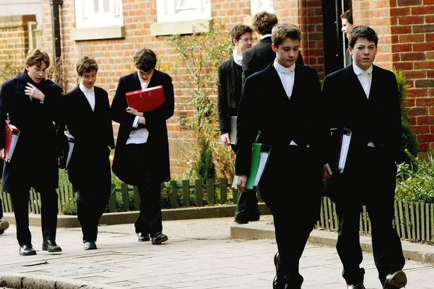
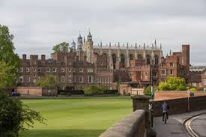
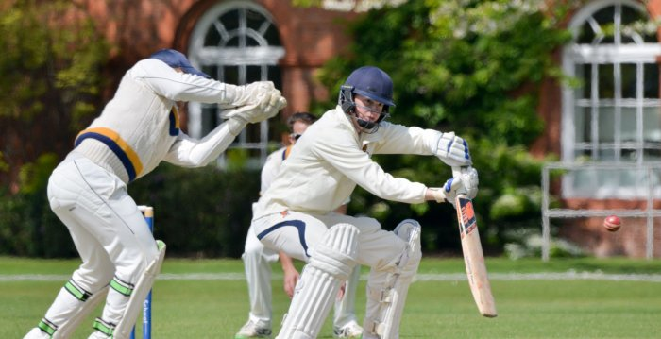
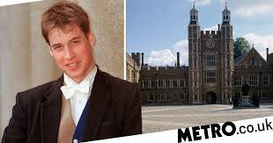
ETON – THE MOST FAMOUS PUBLIC SCHOOL IN THE WORLD
Listen and read about Eton. Do task D in your books.
- u tekstu označite brojevima od 1-7 rečenicu/rečenice gdje se govori o traženom, npr. Captain Hook and James Bond – 1 (famous Old Etonians)

Slide 7
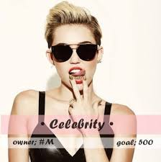
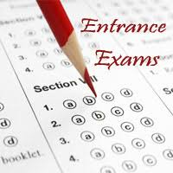
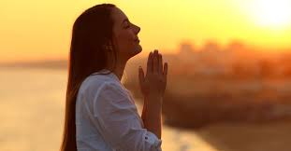
F – page 134 Do you know what these words mean? Translate them in your notebook and answer the questions in your notebooks. - a celebrity = poznata osoba, ‘zvijezda’ - facility = ustanova, postrojenje - to attend = pohađati - prayers = molitve - homesick = nostalgija za domom - to enrol = upisati se (u školu) - an entrance exam = prijemni ispit - fabulous = sjajno, odlično

Slide 8
HOMEWORK – task G, page 134
Have you thought about your future education? Answer the following questions in your notebooks. Do it by tomorrow (we’ll see each other on Teams at 11 o’clock)
New words:
apply for – prijaviti se za (školu)
a careers advisor – savjetnik za zanimanje, karijeru
enrol – upisati se
a well-paid job – dobro plaćeni posao
grammar schools - gimnazije

Slide 9
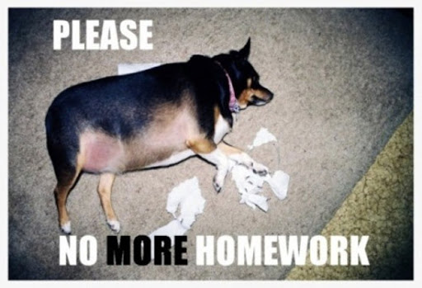
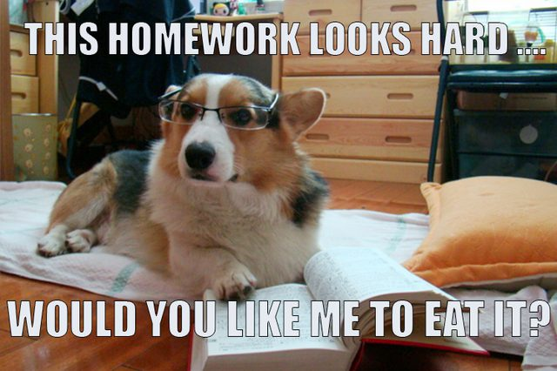
Homework – workbook, pages 125 and 126
Answers to the quiz How much do you know about education in the UK and the USA
1 A GCSEs; B A levels; C SATs
2 C
3 T
4 T
5 T
6 C
7 B
8 A
9 B
10 B

Slide 10
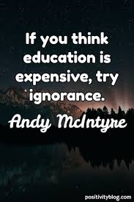
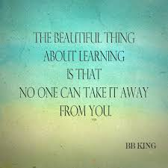
Goodye and I hope that you will enrol in school you choose and that you will be happy.
See you tomorrow!

